Slide 1
CONCESSÕES NOS PORTOS.
A EXPERIÊNCIA ESPANHOLA
1ª CONFERENCIA INTERNACIONAL DE PORTOS
“TRANSPORTE MARÍTIMO PORTUÁRIO – DESAFIOS e EXPECTATIVAS”
CODESA - IFES
Vitoria do Espirito Santo, 3 a 5 de Julio de 2017, Brazil
Ph.D. Civil Eng. José Luis Estrada
Managing Partner
Estrada Port Consulting, SL

Slide 2
Index
  The port system of general interest
  - General features
  - Traffic
  - Some economic figures
  - Organization, principles and objectives
  The management of the port public property
  Some examples of concessions in the Spanish Ports
  Conclusions

Slide 3
General Features

Slide 4
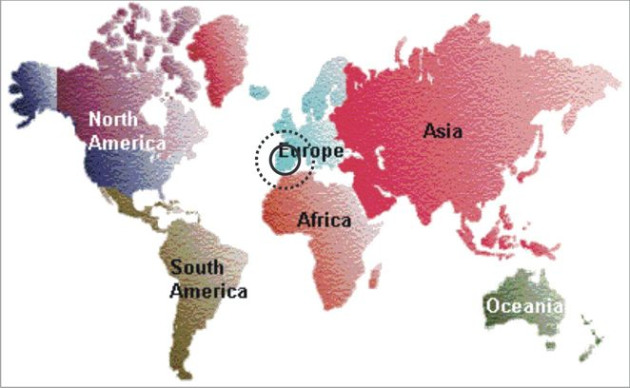
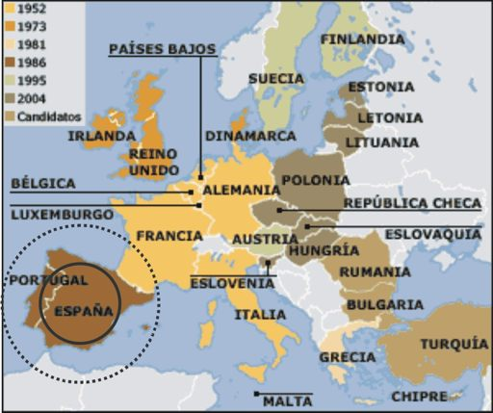
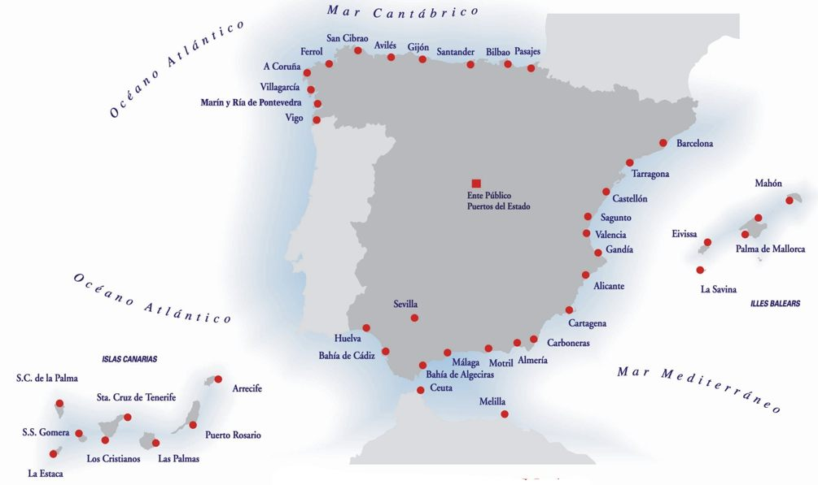
GENERAL FEATURES
LOCATION

Slide 5

GENERAL FEATURES
GEOSTRATEGICAL POSITION
Between the Atlantic and the Mediterranean Sea
Near to the principal all-around-the-world routes (east-west)
Integrated in Europe: trans European networks and gateway for far-east traffics
Gateway for North Africa and The European Union

Slide 6
GENERAL FEATURES
46 commercial ports managed by 28 Port Authorities
Around 8.000 kilometers of coast, 7% of them are devoted to port facilities
The port activity and the maritime transport sector represents in Spain around 20% of the gross added value of the transport sector and about 1,5% of the Spanish national gross domestic product (GDP)
80% of imports and 50% of exports take place through the commercial ports
52% of Spanish commerce with the European Union takes place by sea
96% of Spanish commerce with the rest of the world takes place by sea
THE SPANISH PORT SYSTEM

Slide 7
Traffic

Slide 8
TRAFFIC
TOTAL THROUGHPUT EVOLUTION OF THE SPANISH PORTS (mill. tons)
Source: Puertos del Estado
Elaboration: Estrada
From 2006 to 2016, port traffic increased a 10% rate, and at an accumulated average annual rate of 0,9%.
The figures of 2007 (before crisis) were surpassed in 2015 with 502 Mt. In 2016, the total throughput was 508,9 Mt.
The Port of Algeciras is the first port with 102,8 Mt

Slide 9
TRAFFIC
TOTAL TRAFFIC OF GOODS IN 2016
(508,9 million tons)
GOODS (t)
GENERAL CARGO 235.883.093 |  | 46,35%
SOLID BULKS 91.787.007 |  | 18,04%
LIQUID BULKS 167.761.424 |  | 32,96%
 | TOTAL | 97,35%
OTHER GOODS
FRESH FISHING 232.915 |  | 0,05%
BUNKER AND SUPPLY 10.204.824 |  | 2,01%
LOCAL TRAFFIC 3.052.483 |  | 0,60%
TOTAL |  | 2,65%
TOTAL PORT TRAFFIC (t) 508.921.541 |  | 100%
Source: Puertos del Estado
Elaboration: Estrada
In 2016 the Spanish port system handled 508,9 Mt, 7 Mt more than in 2015, with an increase of 1%.
46% of the goods handled were general cargo.

Slide 10
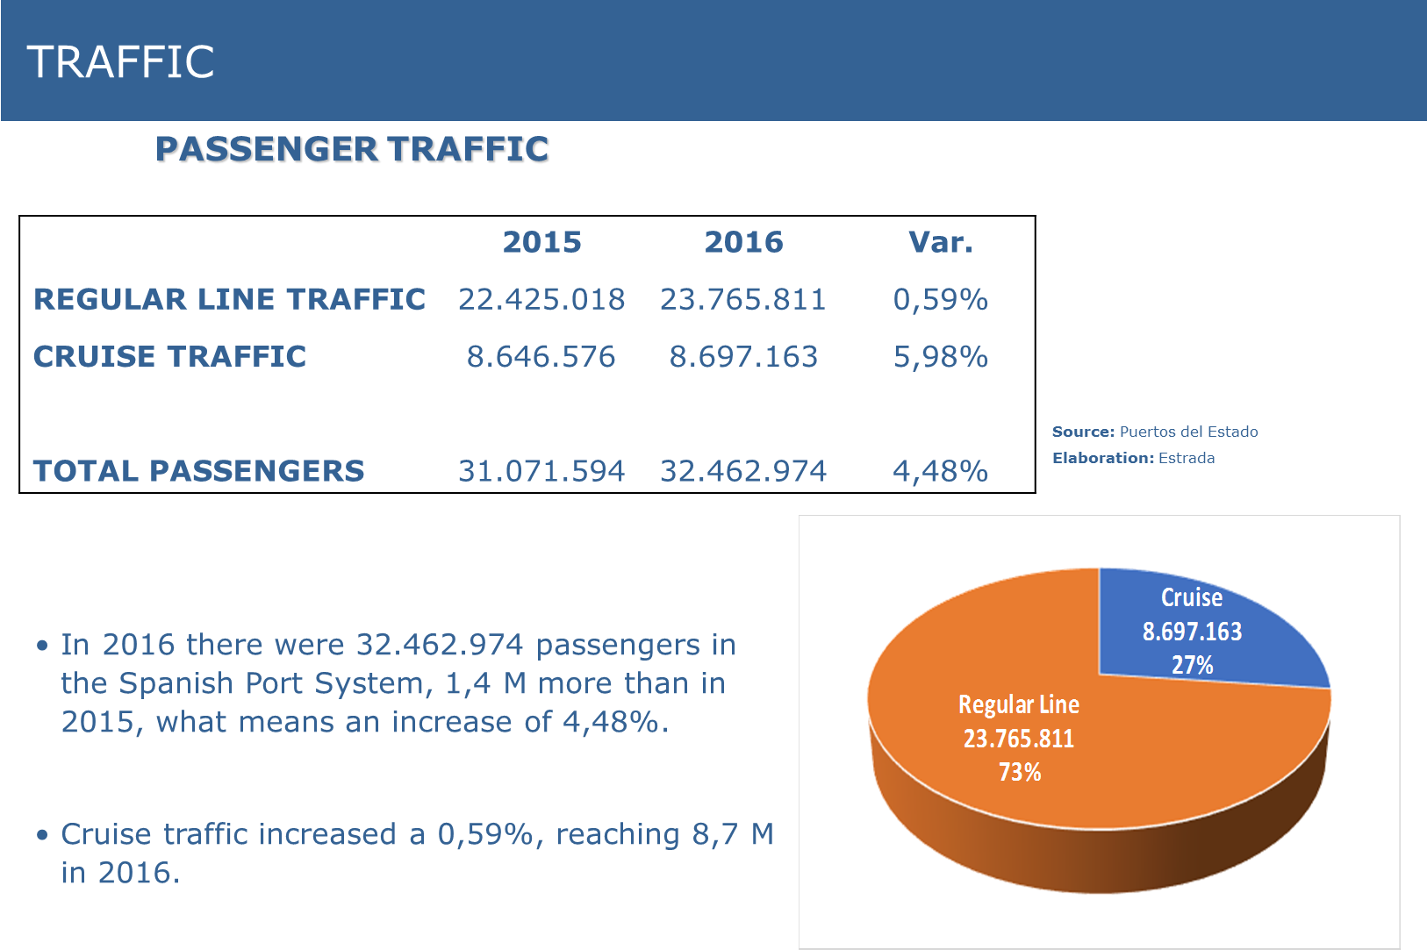
TRAFFIC

Slide 11
TRAFFIC
CONTAINER TRAFFIC EVOLUTION (millions of TEUs)
Fuente: Puertos del Estado
Elaboración: Estrada
Since 2001, the number of TEUs were growing at a 7.4% average rate, until 13,1 M TEUs in 2007. After the crisis in 2009, the traffic carried on growing (except 2013) until 15,08 M TEUs in 2016. The average rate of growing in this period has been 3,6% per year (2009-2016).

Slide 12
TRAFFIC
CONTAINER TRAFFIC BY PORT AUTHORITY (TEUs)
TOTAL PORT SYSTEM IN 2016: 15,08 M TEUS
Fuente: Puertos del Estado
Elaboración: Estrada
The Port Authority of Algeciras is heading the Spanish ranking, with 4,7 M TEUs in 2016.
The three first Port Authorities (Algeciras, Valencia and Barcelona) handle the 77% of the traffic and the first five handle the 87% of the container traffic in TEUs.

Slide 13
TRAFFIC
CONTAINER TRAFFIC: TRANSIT VS I/E
Source: Puertos del Estado
Elaboration: Estrada
The transit (transhipment) of containers represents more than 50% of the container traffic in TEUs (52% in 2016)

Slide 14
Some economic figures

Slide 15
ECONOMIC FIGURES
REVENUES/CASH FLOW EVOLUTION (millions of euros)
Fuente: Puertos del Estado
Elaboration: Estrada
The total operating revenues in 2015 of the whole system reached 1.004 M €, nearly the same as in 2014.
The cash flow reached in 2015 the figure of 494 M €, 6,4% less than in 2014.

Slide 16
ECONOMIC FIGURES
AVERAGE ECONOMIC IMPACT OF THE DIFFERENT TAXES ON THE REVENUES OF THE PORT SYSTEM
Tax of Occupation 25%
Tax of Activity 12%
Taxes of utilization 53%
Tax of the ship (T1) 18%
Tax of the goods (T3) 26%
Tax of the passengers (T2) 7%
Other taxes of utilization 2%
Tax of navigational aids 1%
Other incomes of bussines 9%

Slide 17
ECONOMIC FIGURES
ECONOMIC FIGURES
EVOLUTION OF PUBLIC AND PRIVATE (NOT PUBLIC) INVESTMENT
This evolution of the private investmens is simultaneous to the access of the private sector to the port services market, and is due to the development of the landlord model, with concessions, particularly from the midle 90’s
Source: Puertos del Estado
Elaboration: Estrada

Slide 18
ECONOMIC FIGURES
PUBLIC INVESTMENTS (PORT AUTHORITIES) 2015–FUNCTIONAL SPLIT

Slide 19
ECONOMIC FIGURES
NOT PUBLIC INVESTMENTS 2016 - FUNCTIONAL SPLIT

Slide 20
Organization, principles and objectives

Slide 21
ORGANIZATION, PRINCIPLES AND OBJECTIVES
PUERTOS DEL ESTADO
It is a public Organism dependent on the Ministry of Public Works (Ministry of Fomento), with global responsibilities for the whole Spanish General Interest Ports.
General main functions:
  - Implementation of governmental port policy
  - Co-ordination and control of the efficiency of ports
PORT AUTHORITIES
  Public entities depending on the Ministry of Fomento through Puertos del Estado, with the responsibility on the administration, management and development of the ports The Board of Directors (10-13) is composed by members of the Central State, Comunidad Autonoma (Region), Town Hall, Bussines Organizations and Unions relevants in the port industry. The President is appointed by the Comunidad Autónoma.

Slide 22
ORGANIZATION, PRINCIPLES AND OBJECTIVES
PRINCIPLES AND OBJECTIVES OF THE SPANISH PORT SYSTEM (I/II)
  Functional and management autonomy of each Port Authority and Puertos del Estado.
  The whole port system and each Port Authority must be economically sustainable. Nevertheless, they can get aids and funds from the General Budget of the State and other Institutions.
  Optimization of the economics management.
  Solidarity among Port Authorities: Compensation Fund/Accesibility Fund
  Competition among ports

Slide 23
ORGANIZATION, PRINCIPLES AND OBJECTIVES
PRINCIPLES AND OBJECTIVES OF THE SPANISH PORT SYSTEM(II/II)
  Port tariffs partially regulated by the government through Puertos del Estado.
  Improving ports competitivity
  Promoting the presence of private companies in port activities: port services and concessions. The Port Authority can´t render port services (except exceptional situations)
  Minimum rate of profitability of the system is 2,5%

Slide 24
ORGANIZATION, PRINCIPLES AND OBJECTIVES
THE SPECIFIC ROLE OF THE PORT AUTHORITY
Port Authorities: planning the port, supply the basic infrastructures and port spaces (land and water), managing the public property through the private companies by means of granting authorizations and concessions, regulation of the port activities, coordination and control of the safety and security and environment, enhance efficiency, productivity end quality of the port services.
Landlord (Advanced) model: Port Authority acts as a leadership, engine, and promoter of new initiatives: TICs, logistics, intermodal, dry ports, etc., jointly with the Port Community and logistics companies.

Slide 25
ORGANIZATION, PRINCIPLES AND OBJECTIVES
  Rendering port services
  Exploitation of the spaces and facilities by means of authorizations and concessions, usually associated to the construction of superstructures, facilities and equipment (and infrastructures too)
THE PRIVATE SECTOR ROLE

Slide 26
The management of the port public property

Slide 27
THE MANAGEMENT OF THE PORT PUBLIC PROPERTY
MAIN CHARACTERISTICS (I/III)
The ownership of the port public property is the State . It is managed by the Port Authority.
The Port Authority gives a title (authorization or concession) to a private company to occupy exclusively part of the port public property
To assure/guarantee of the general interest
To promote and enhance the presence of the private initiative in ports for financing, construction and operation of the port facilities and rendering services, through authorizations and concessions (of public property and of public works)
.

Slide 28
THE MANAGEMENT OF THE PORT PUBLIC PROPERTY
MAIN CHARACTERISTICS (II/III)
Needs to be agree to the Special Plan (urbanistic) and Uses Plan of the port
Profitability and efficiency: a minimum level of activity or traffic is forced.
“Occupation tax”. The concessionaire will pay a yearly tax for the occupation of the public property. Regulated by the Law
The “Occupation tax” is a percentage of the land (water) value
- 5,5% for land areas of intermodal transference
- 6,5% for complementary areas: logistics, industrial, …
- 7,5% for port-city interaction areas

Slide 29
THE MANAGEMENT OF THE PORT PUBLIC PROPERTY
MAIN CHARACTERISTICS (III/III)
When the occupation includes works and facilities, the occupation tax of the land must be incremented in a percentage of the value of the works plus a 100% of the depreciation.
“Activity tax”. The concessionaire will pay a second tax for doing commercial, industrial activities and services on the public property.
The law establish a minimum and a maximum
To compensate the rigidity of the taxes, there exists some possible bonus or amelioration, depending on the type of investment. ( A tax is a tribute)
The Port Authority will require to the concessionaire, the information that needs

Slide 30
THE MANAGEMENT OF THE PORT PUBLIC PROPERTY
AUTHORISATIONS OF PUBLIC PROPERTY
Occupying port public property to develop some commercial or industrial activity
Dismounting facilities or without it.
Less than 3 years term, including extensions o extra time
Precarious character.
Occupation Tax and Activity Tax
Personal character and not transferable
Two ways for granting: From the demand of the concerned and by public bidding by the Port Authority (concurso publico)

Slide 31
THE MANAGEMENT OF THE PORT PUBLIC PROPERTY
CONCESSIONS OF PUBLIC PROPERTY (I/III)
Occupying port public property to develop some commercial or industrial activity.
To accomplish the general conditions of the “Pliego de Condiciones Generales del Ministerio de Fomento” and the specific conditions of the Port Authority
Works and facilities fixed, or not
More than 3 years term and not bigger than 50 years, including extensions or extra times.
Exceptionally till 75 years

Slide 32
THE MANAGEMENT OF THE PORT PUBLIC PROPERTY
CONCESSIONS OF PUBLIC PROPERTY (II/III)
The title of concession includes
- Conditions for occupation of the public property
- Conditions for the activity or services rendered. License
The concession term will coincide with the term of the license for service rendering, if any
Occupation tax
Activity tax

Slide 33
THE MANAGEMENT OF THE PORT PUBLIC PROPERTY
CONCESSIONS OF PUBLIC PROPERTY (III/III)
Yearly minimum traffic volume or activity.
The transparency of the proces is guarantee through: Competition among Projects and/or Public Information.
The concessionaire will have the right of charging the services provided, according to the maximum tariffs approved by the Port Authority in the concession title

Slide 34
THE MANAGEMENT OF THE PORT PUBLIC PROPERTY
Vinculation of the object with the port activity
Availability of port space
Investment volume of the concession and economical - financial study
Term to make the works
Adaptation to the planning and port management
Increment of the port activity
Time to amortize the investments (vida util)
CRITERIA TO FIX THE TERM OF A CONCESSION OF PORT PUBLIC PROPERTY (I/II)

Slide 35
THE MANAGEMENT OF THE PUBLIC PORT PROPERTY
TWO POSSIBILITIES FOR GETING A CONCESSION (I/II)
1. From the demand of a private company
Public Competition of projects is necessary (one month)
Moreover, it is necessary a Public Information of the project (20 days).
The duration of the official process can last a minimum ofabut 4 months. The agility is important

Slide 36
THE MANAGEMENT OF THE PUBLIC PORT PROPERTY
TWO POSSIBILITIES OF GRANTING A CONCESSIONS (II/II)
2. Through a public tender driven by the Port Authority (concurso publico)
The Port Authority always can decide it
Public information, not less than 20 days term
There is a third possibility to get a concession: direct granting, in some special cases, particularly when the surface is less than 2.500 m2 or wirh lineal facilities (pipes, cables, etc). Not necessary the Competition of Projects nor Public Information

Slide 37
THE MANAGEMENT OF THE PUBLIC PORT PROPERTY
MAIN CONDITIONS FOR GRANTING A CONCESSION (I/II)
Object of the concession
Term
Zone to be occupied
Basic Project of the works and facilities. After Construction Project
Conditions of protecction of the environment
Occupation Tax and Activity Tax

Slide 38
THE MANAGEMENT OF THE PUBLIC PORT PROPERTY
MAIN CONDITIONS FOR GRANTING A CONCESSION (II/II)
Guarantee of construction and of explotation
Causes of expiration of the concession
Minimum activity or traffic
Others

Slide 39
THE MANAGEMENT OF PUBLIC PORT PROPERTY
Breakdown of investment in a Container Terminal
 |  | PORT AUTHORITY | Operator
1 | Muelle/ Quaywell (1) | X | X
2 | Relleno y precarga/ Filling (2) | X | X
3 | Pavimento y electricidad / Pavement and electricity |  | X
4 | Equipo/Equipment |  | X
5 | Edificios/Buildings |  | X
6 | Dique/Breakwater | X
(1) If the private makes the quay Wall, there is a reduction of the oficial “Tax of ship” (T-1) . The private can charge a tarif to ship.
(2) If the private makes the reclamation works, there is a reduction of the “Occupation tax”.
Fuente: Estrada

Slide 40
THE MANAGEMENT OF THE PORT PUBLIC PROPERTY
THE CONCESSION OF PUBLIC WORK (I/II)
Based on a more general Law 13/2003, which regulates in Spain, the concession of public works, in general.
The Port Authorities can promote the construction of port public works as administartive concesions.
Object :
  ◊ Construction of a new port or a new part of a port, which can be exploited, totaly independently
    ◊ Open to public use or general exploitation

Slide 41
THE MANAGEMENT OF THE PORT PUBLIC PROPERTY
THE CONCESSION OF PUBLIC WORKS (II/II)
  Right of the concessionaire to get a payment
  ◊ Exploitation of works or the exploitation plus a price
  ◊ Others, regulated by the Law
  The concessionaire will asume the economical risks derived from construction and exploitation.
  To render port services on the public work, the concessionaire needs a license
  Maximum term, less than 40 years, but extendible, according to the general Law.

Slide 42
Some examples of concessions in the Spanish Ports

Slide 43
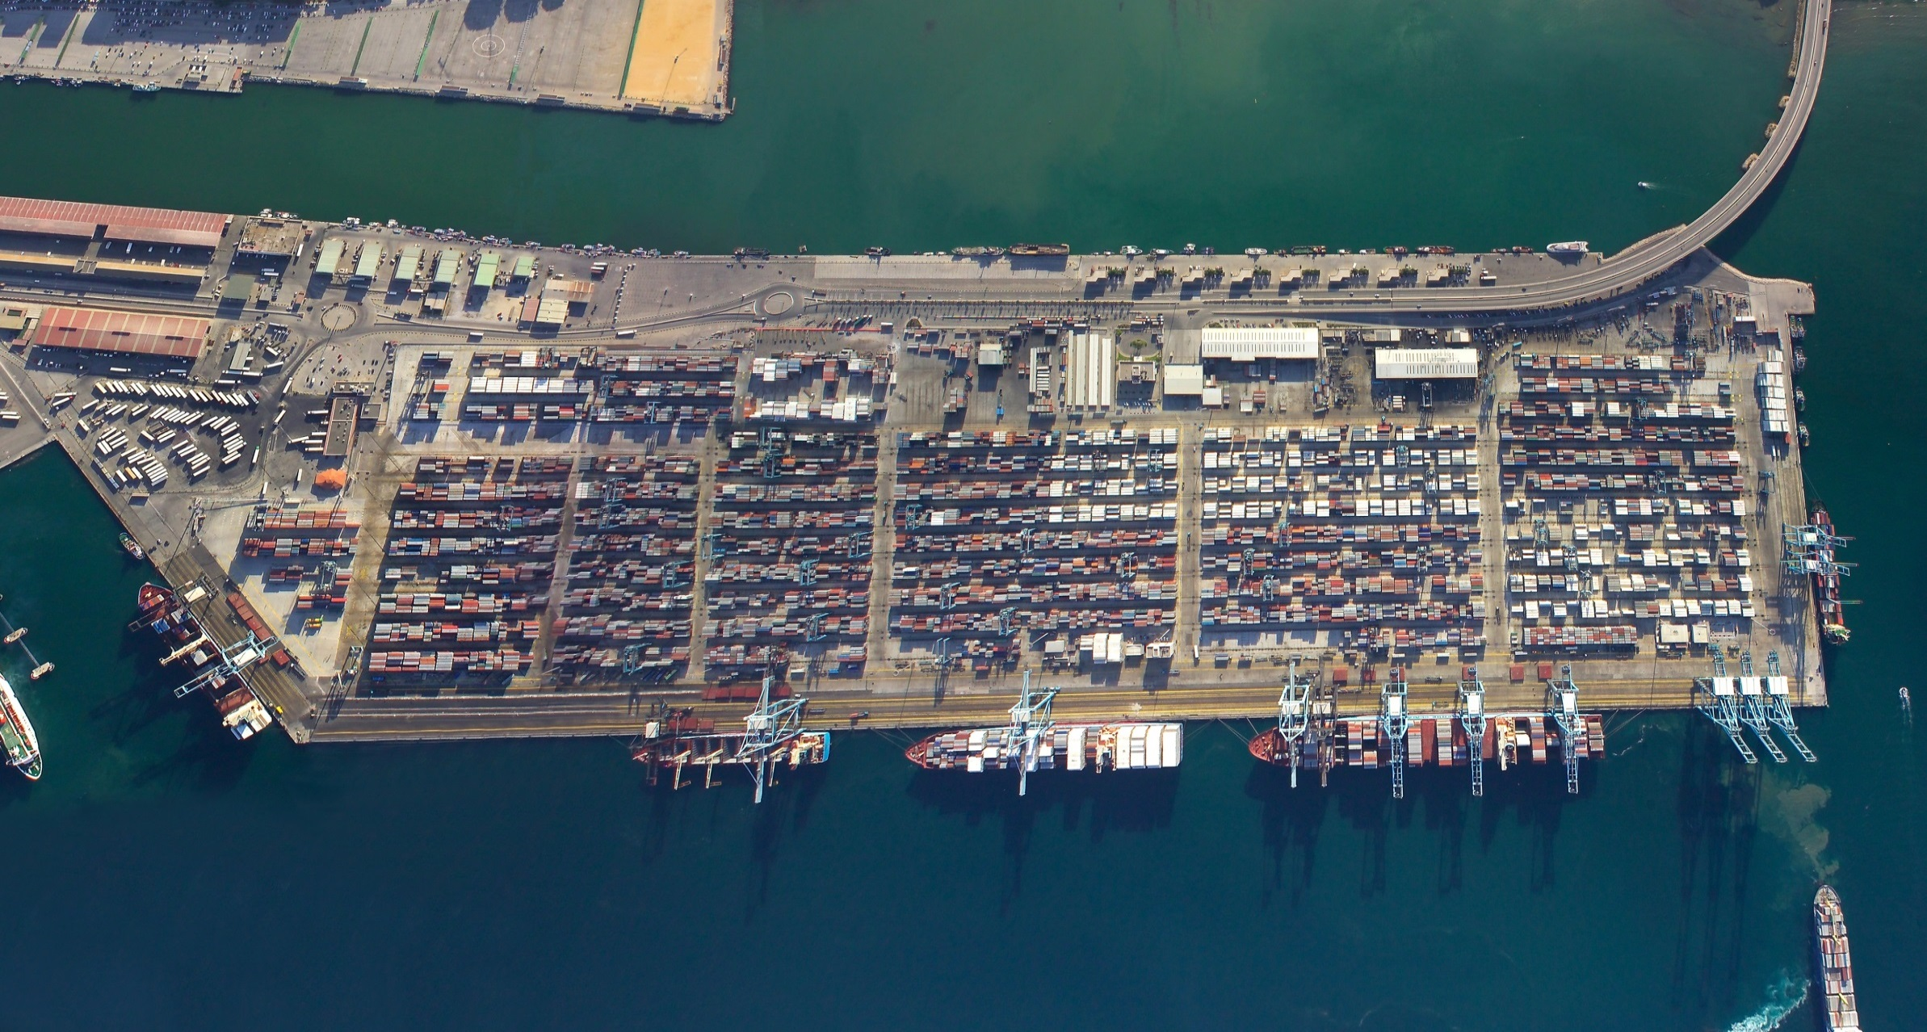
CONTAINER TERMINALS IN THE PORT OF ALGECIRAS
APM TERMINALS
Fuente: APBA

Slide 44
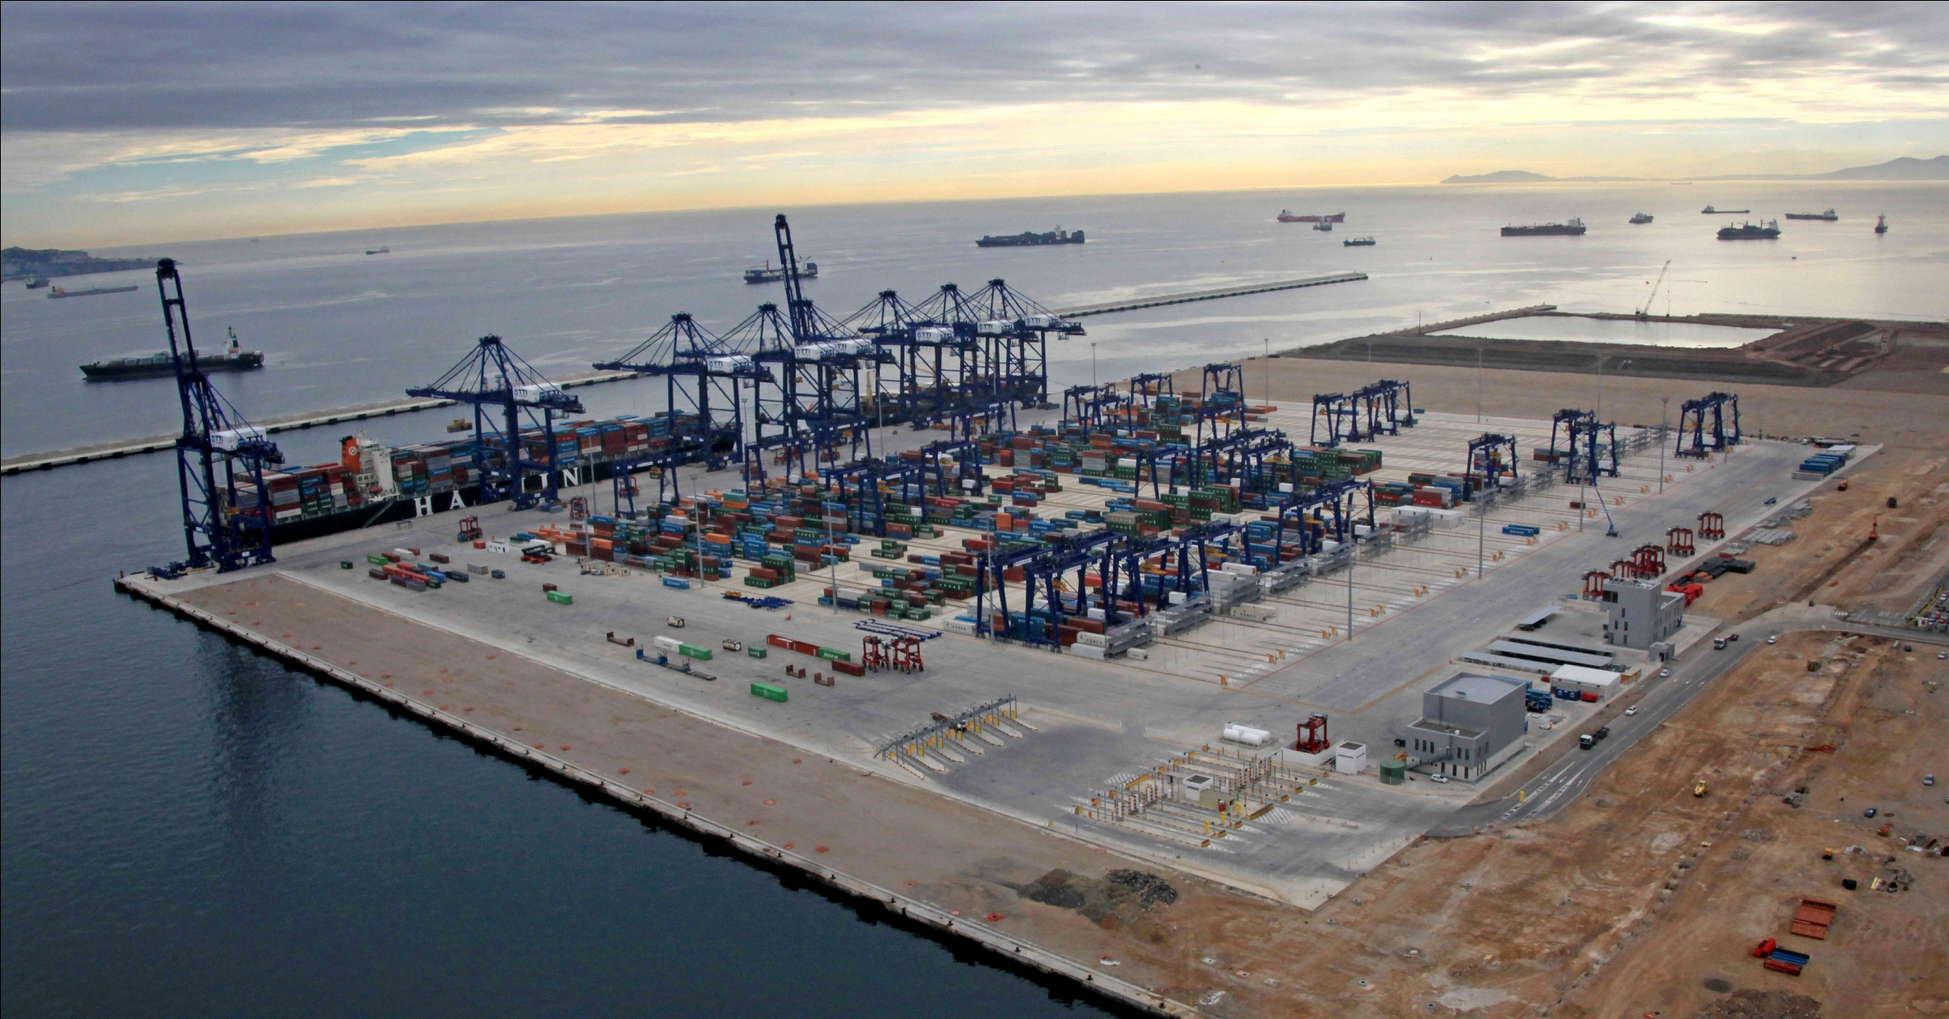
CONTAINER TERMINALS IN THE PORT OF ALGECIRAS
TOTAL TERMINAL INTERNACIONAL ALGECIRAS (TTI-A)
ESTE
850 m
-18,50 m
NORTE
550 m
-18,50 m
TERMINAL PÚBLICA (Common user terminal)
Fuente: APBA, TTI-A
Elaboración: Estrada

Slide 45
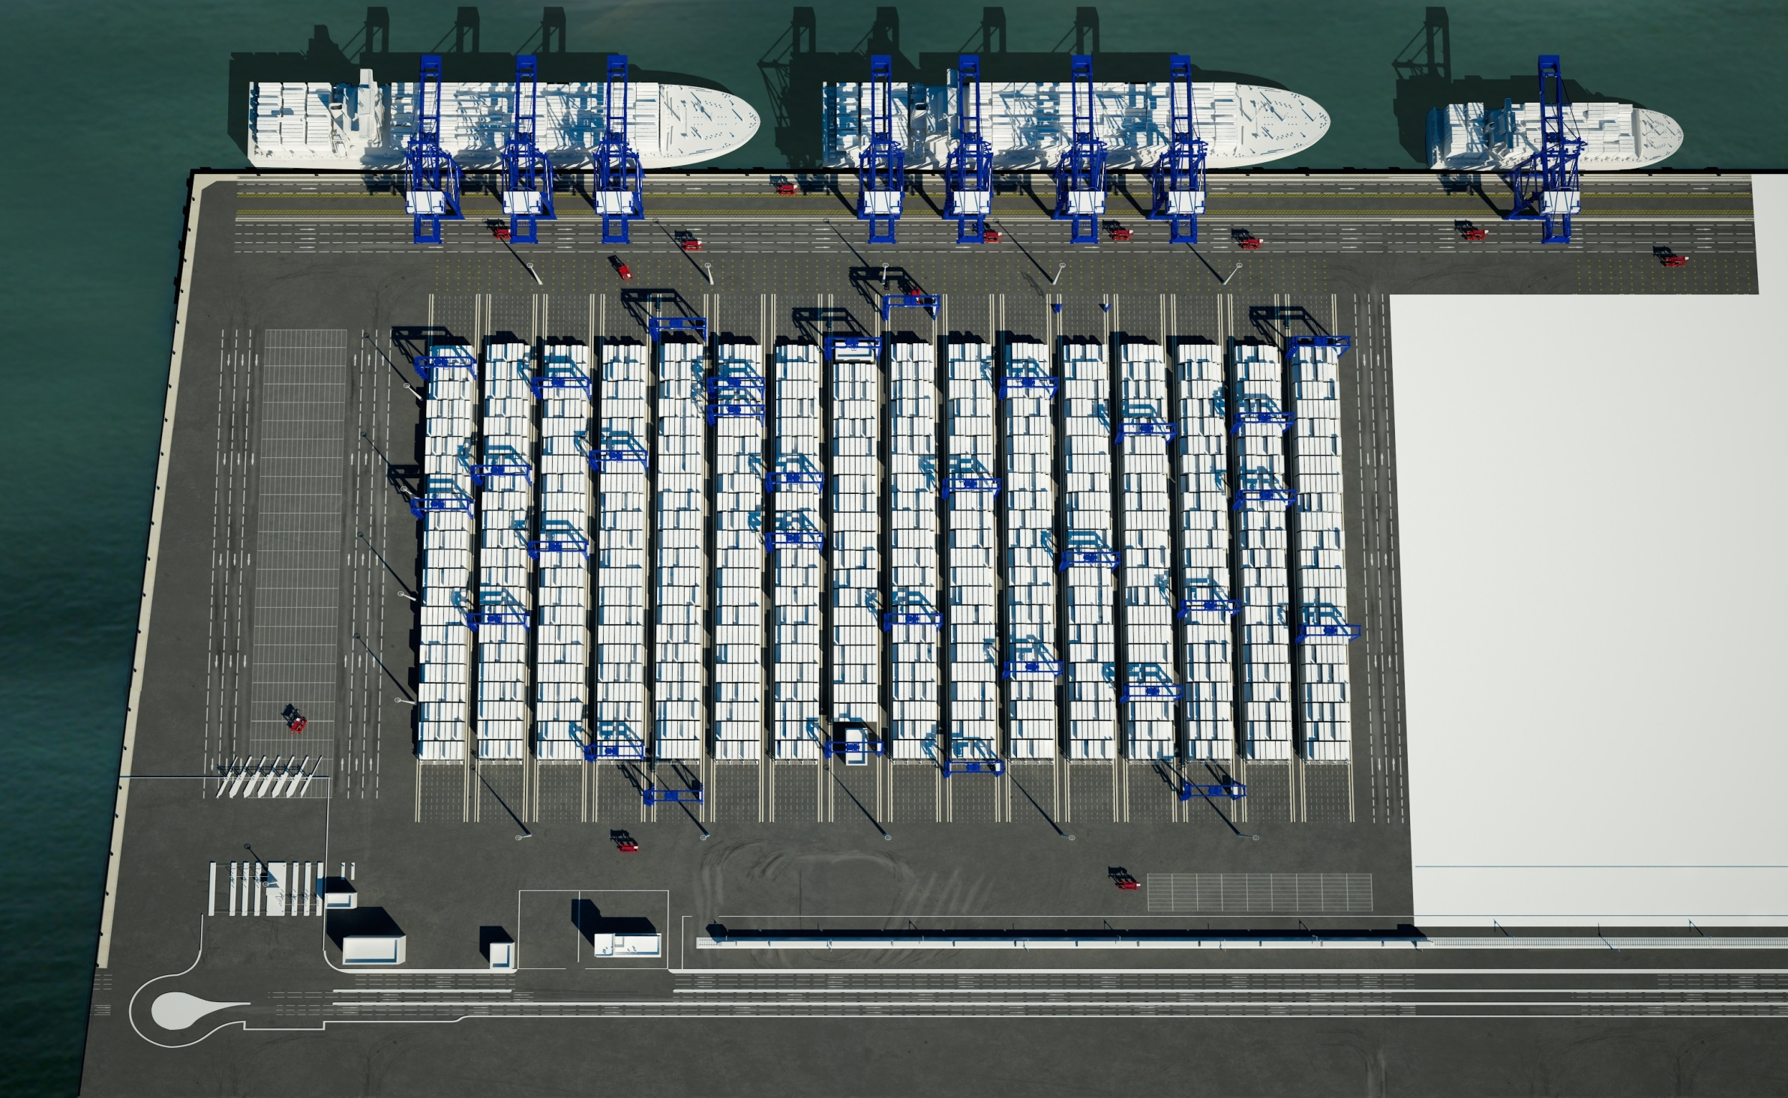
CONTAINER TERMINALS IN THE PORT OF ALGECIRAS
Fuente: TTI-A
TOTAL TERMINAL INTERNACIONAL ALGECIRAS (TTI-A)

Slide 46
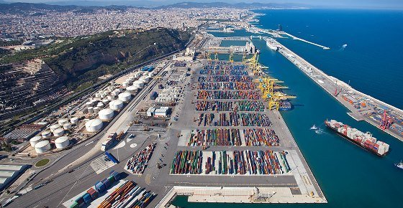
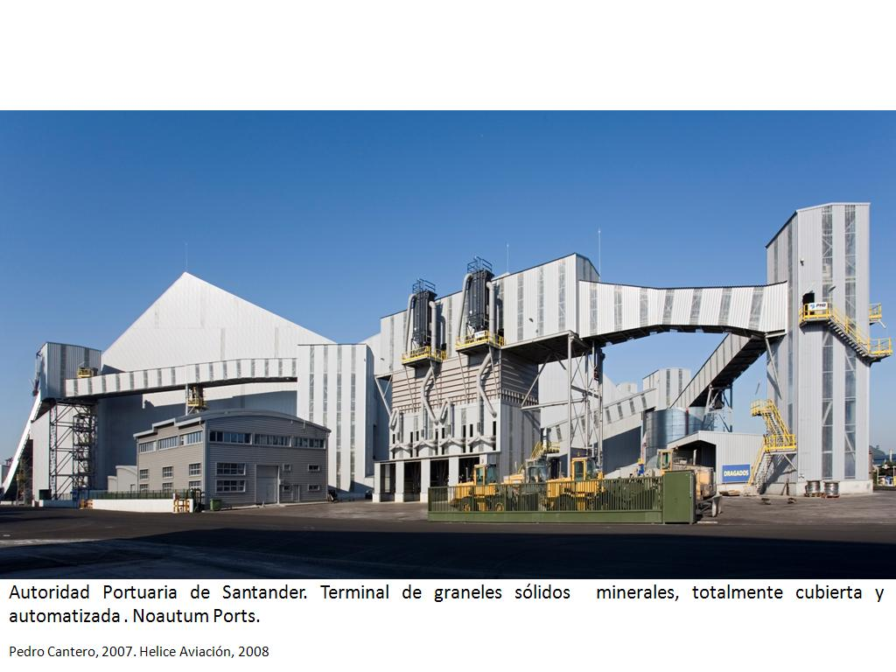
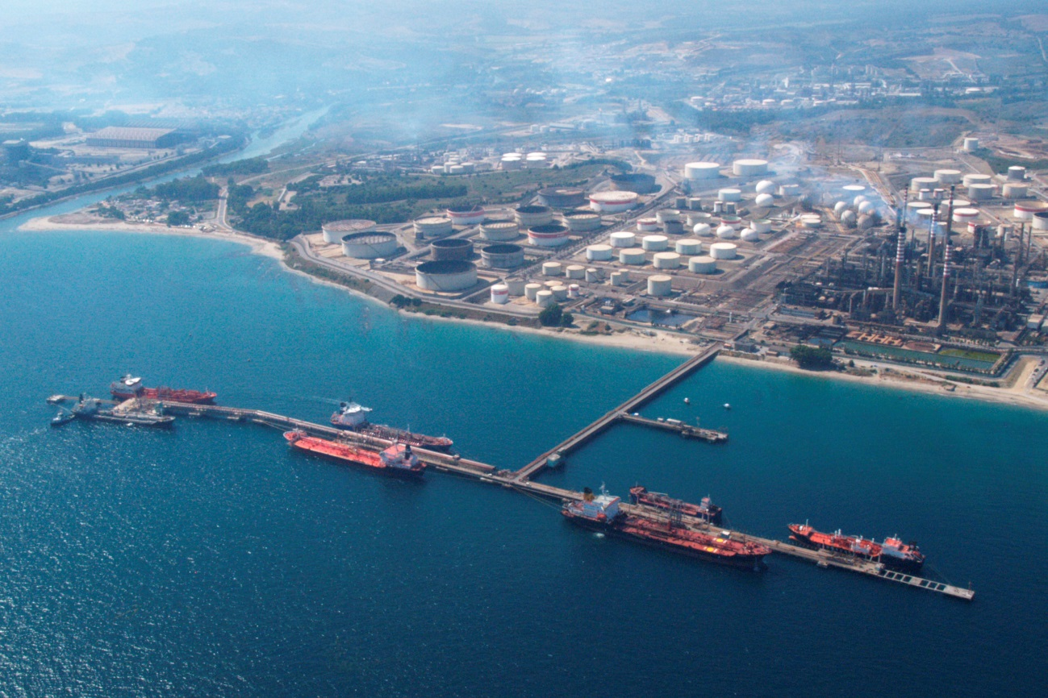
OIL TERMINALIN THE PORT OF ALGECIRAS
APM TERMINALS - BARCELONA
APM TERMINALS - BARCELONA
CEPSA OIL TERMINAL. PORT OF ALGECIRAS

Slide 47
SOLID BULK TERMINAL IN THE PORT OF SANTANDER

Slide 48
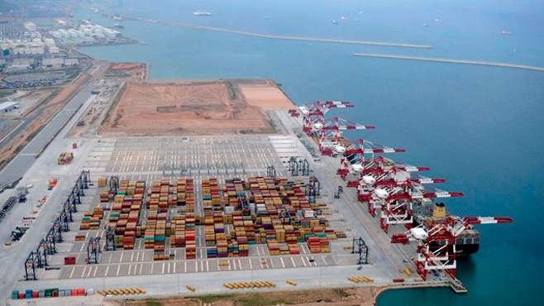
APM TERMINALS - BARCELONA
The Port of Barcelona
Containers
APM TERMINALS - BARCELONA
Container Terminal BEST (common user terminal)
HUTCHINSON PORT HOLDINGS

Slide 49
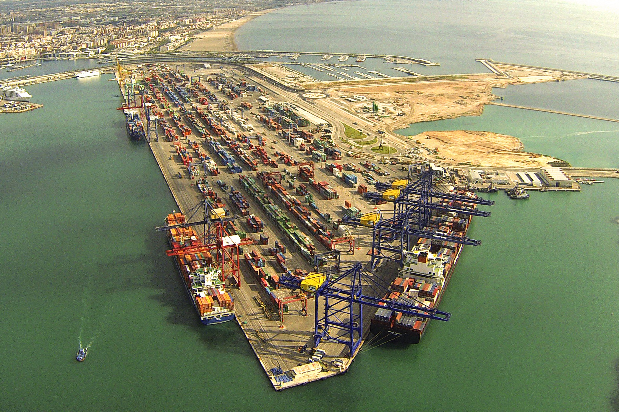
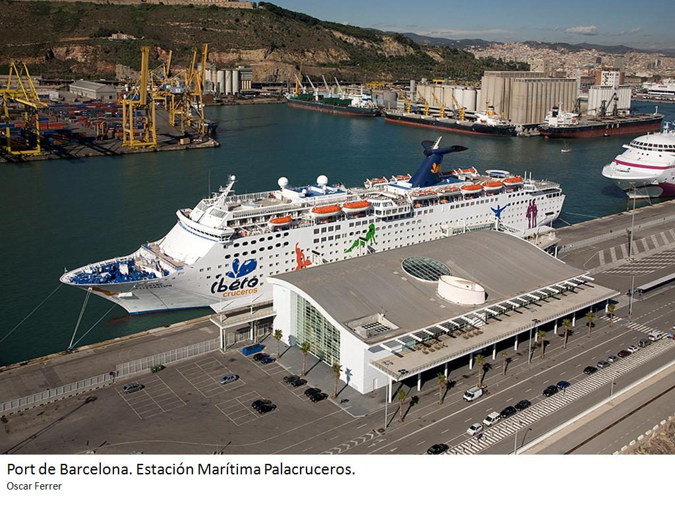
APM TERMINALS - VALENVCIA
CRUISERS TERMINAL “D” OF CARNIVAL (dedicated terminal)

Slide 50
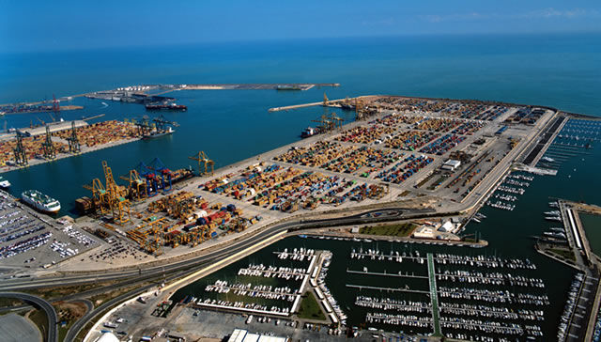
COSCO TERMINAL- VALENCIA
COSCO TERMINAL - VALENCIA

Slide 51
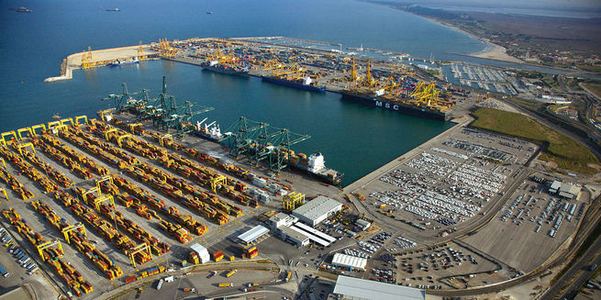
MSC TERMINAL - VALENCIA
MSC TERMINAL - VALENCIA

Slide 52
CRUISERS TERMINAL IN THE POT OF BARCELONA
CRUISERS TERMINAL “D” OF CARNIVAL (dedicated terminal)

Slide 53
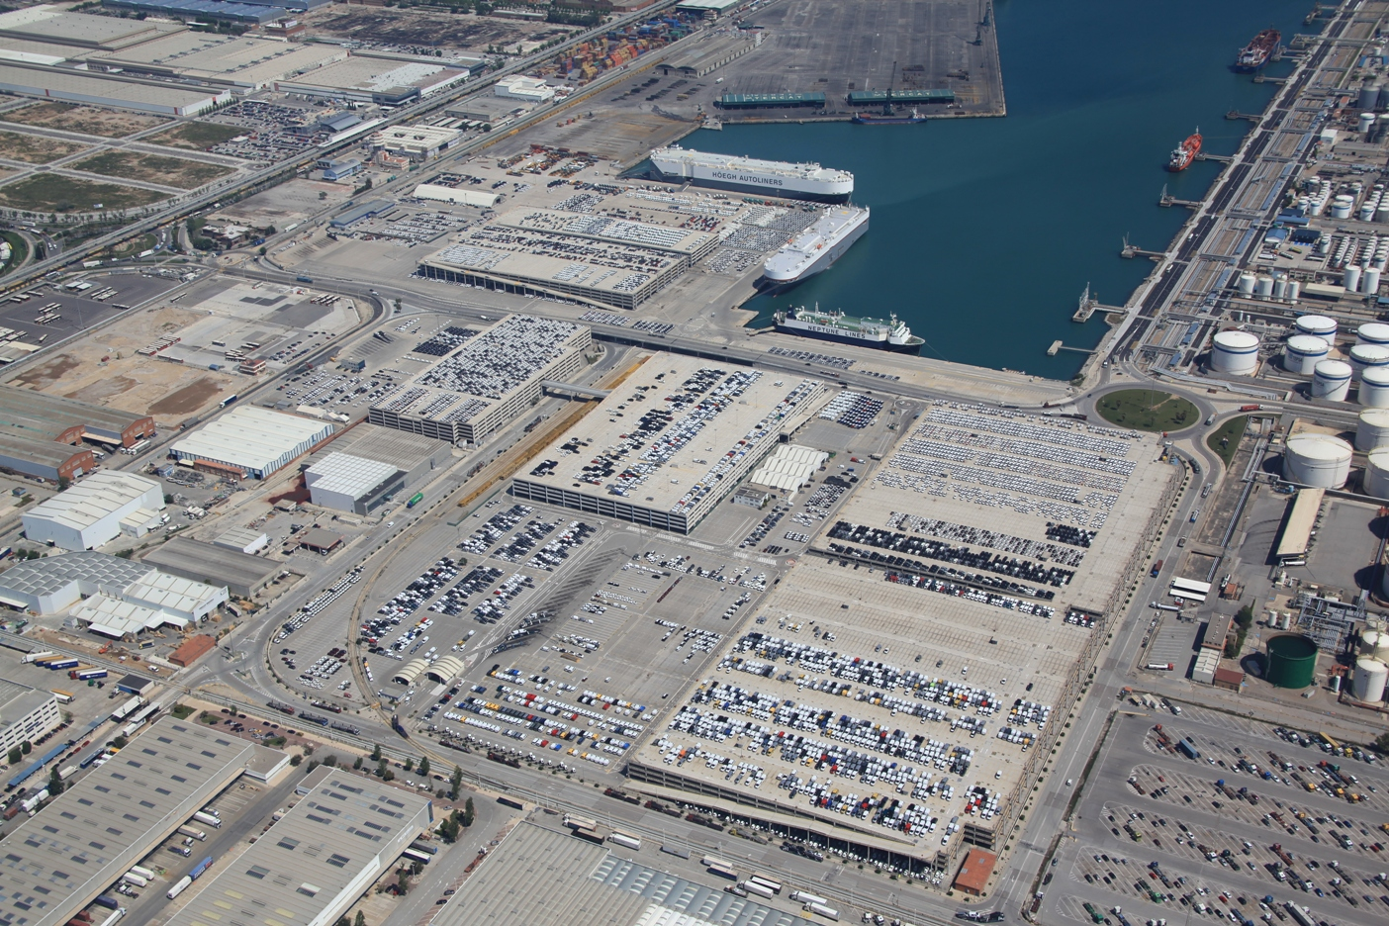
The Port of Barcelona
Vehicles
Vehicles Terminals (common user terminal). AUTOTERMINAL SA

Slide 54
CONCLUSIONS
  Spanish ports are estuctured as a Landlord (advadced) port model
  One of the main objectives of the Spanish port policy is promoting and enhancing the presence of the private companies in the port activity
  There are two mecanismes: providing port services and granting concessions to the pivates.
  The concesions of port public property are the fundamental tool for managing the present Spanish ports
  Through a concesion of port public property, the private finances, constructs and operates a part of the port (terminal, etc).
  The concessionaire pays two types of taxes: Occupation and Activity
  The maximun term is 50 years, including posible extensions . Exceptionally it can be 70 years
  That´s the Spanish model of participatopn public – private (PPP)
  s

Slide 55
Muito Obrigado pela sua atenção!
José Luis Estrada Llaquet
jlestrada@estradaportconsulting.com
www.estradaportconsulting.com

