Slide 1
REALIZAÇÃO
Good Governance Practices in the Port Sector
Shuo Ma, Professor
World Maritime University
12, Sept. 2023
Vitoria

Slide 2
Port Governance – System Design
How to define and measure the performance of a port is the most critical issue of port governance.
Under a ”landlord port” model, the governance can be divided into two different levels:
The intuitional level
The corporate level
At each level, there are two types of matters to address:
The definition of governance objectives
The handling of most critical governance issues

Slide 3
Objective(s) of Institutional Port Governance
Multiple objectives
The importance of focus
The primary (fundamental) objective
”SUSTAINABILITY”
Three dimensions of “Sustainability” Objective
Sustainable growth and economic contribution
Sustainable social coherence and responsibility
Sustainable environmental leadership

Slide 4
Critical Issue for Good Institutional Port Governance
There are different ways to achieve the agreed governance objective. Different ports have different issues to handle. But the most critical issue, which is common to all ports with good institutional governance is:
“ACCOUNTABILITY”
Though sounds obvious, it is often the worst implemented element
The KPI system based on sustainability performance

Slide 5
Objectives of Corporate Port Governance
The most often used objectives are:
Efficiency (e.g. high productivity), and
Effectiveness (e.g. satisfied customers)
The importance of a competitive environment
Create, protect and maintain a good and healthy market environment for companies to strive
Ref. Global port performance index (World Bank)
Port performance defined

Slide 6
Critical Issues for Good Corporate Port Governance
Infrastructure development
Balancing the future need with other priorities, including environment concerns
Technological adoption
Technical and financial risks, and social/personnel concerns and resistances
Social and labor concerns
Social impact of automation and importance of training
Impact of trade dynamics
Responses to shifts in demand, supply chains and geographical factors

Slide 7
Case: The Port of Singapore:
Emphasis on long-term planning,
Stakeholder engagement, and
Continued innovation
have led the the development cutting-edge port facilities and services. The use automation and AI has contributed to the port’s efficiency and international competitiveness.
Case: The Port of Rotterdam
Stakeholder collaboration
Innovation
Sustainability
have led to a Master Plan striking a good balance between economic, environmental and social factors.

Slide 8
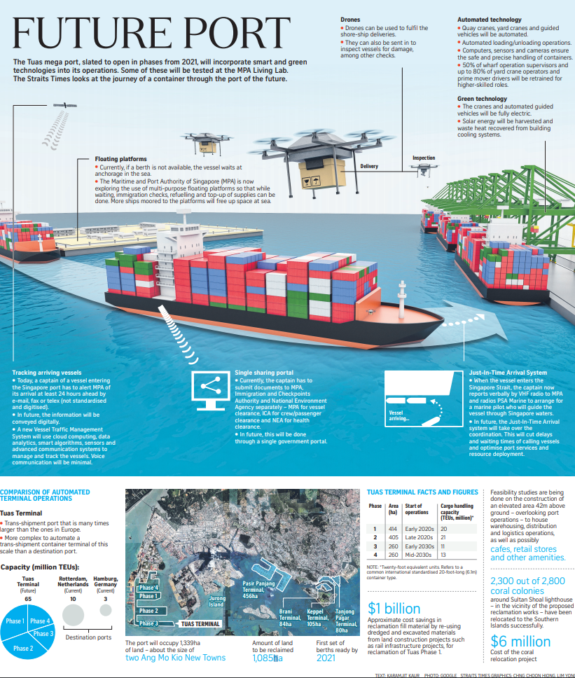
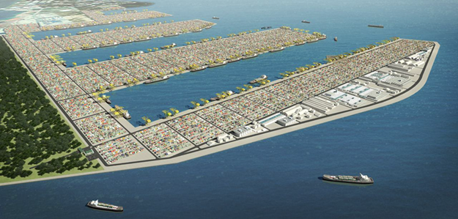
TUAS Port – Singapore
A consolidated mega terminal with 66 berths, 26km, and a total capacity of 65 million TEU, for 2040
Innovative highlights
Design: consolidation
Construction: Caissons
Berthing: JIT
Handling: Semi- automation
Documentation: online
Energy: electrification
Warehouses in the air.
Waiting time: not wasted
2012 announced by Minister; 2015 phase 1 reclaim work started; 2018 phase 2 started; Nov 2021 reclaim work at phase 1 completed, Dec 2022, first 2 berths at phase 1 operational.

Slide 9
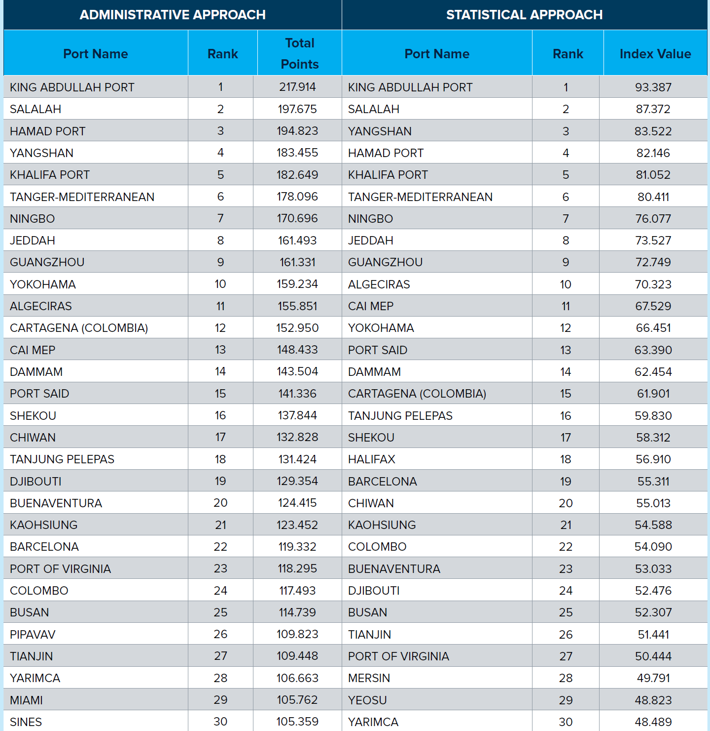

Slide 10
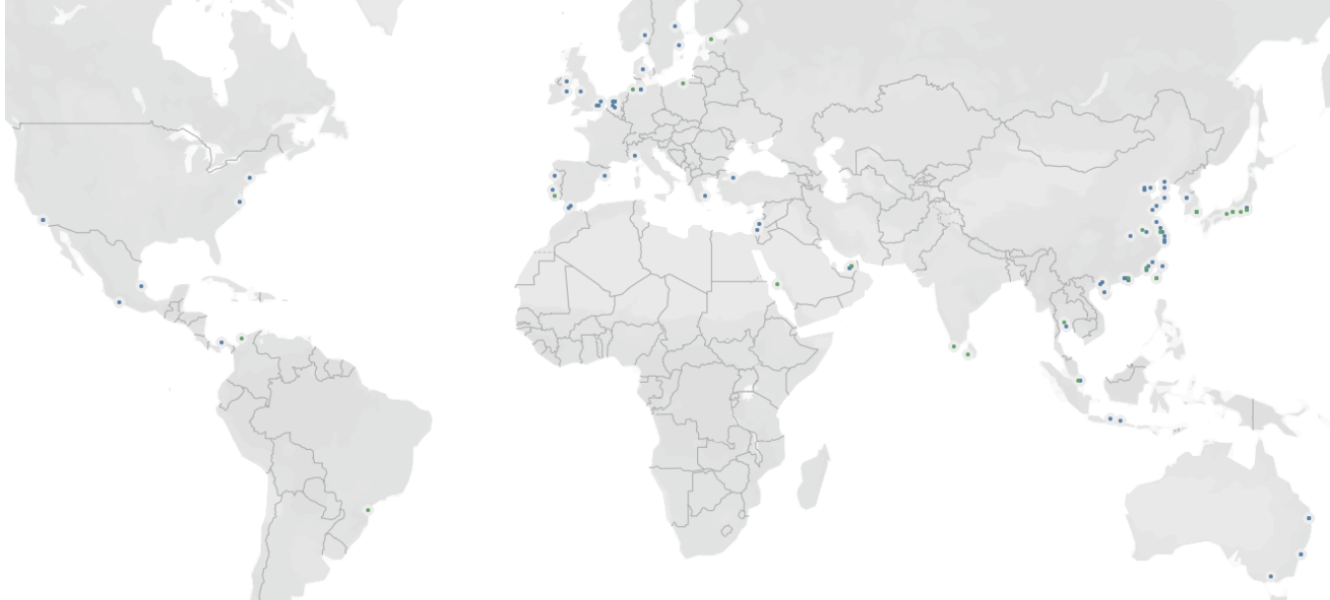
World Automated Container Terminals up to June 2023 – incl. planned

Slide 11
THANK YOU
2023.09.12.

